Slide 1
Content Management System
Lecturer: Ngo Huy Bien
Software Engineering Department
Faculty of Information Technology
VNUHCM - University of Science
Ho Chi Minh City, Vietnam
nhbien@fit.hcmus.edu.vn

Slide 2

Objectives

Slide 3

Contents

Slide 4

References
Andreas Ruping (2009). Where Code and Content Meet. Design Patterns for Web Content Management and Delivery, Personalization and User Participation.

Slide 5
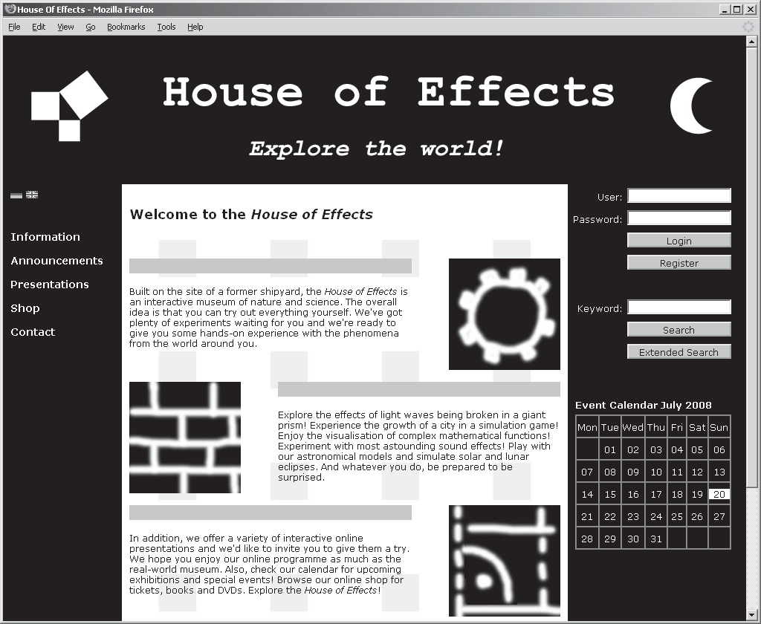
Case Study

Slide 6
Custom Software Development
Of course, you can (and should) use tools such as a content management system, a web server, web application frameworks, tag libraries, a search engine and perhaps others, and these tools provide much of the necessary standard functionality.
But standard functionality isn’t all you need – it is likely that you will have to meet more specific requirements.
Possible examples include a specifically designed content model, personalisation strategies, individual page layouts and support for different output media.
To meet such requirements, custom software development becomes necessary.

Slide 7
Custom Web Content
An essential part of that custom software needs to handle the web content required by a site.
Web content can cover all sorts of digital assets, including text, pictures, videos or other multimedia objects.
To this end, there are two worlds that you need to balance.
One is the world of content, with its underlying models, classifications and lifecycles.
The other is the world of code, where the term ‘code’ is meant to summarise those software techniques and mechanisms necessary to represent content on the web and to implement user interaction.

Slide 8
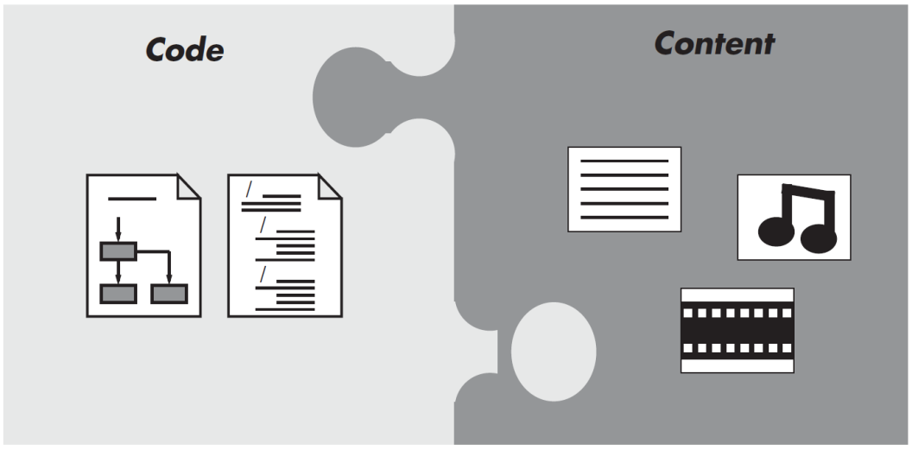
Content And Code
Starting at the point where code and content meet, it aims to explain how these two worlds go together, offering an approach that aligns the requirements from either perspective.
Code and content are viewed as interlocking jigsaw pieces.
Neither content nor code are going to be seen in isolation.

Slide 9
Why CMS Patterns
First, you’ll probably be using a content management system. There are many systems available on the market, so it is unlikely you will have to develop your own.
Second, you will probably be using frameworks for web development, such as Struts, Java Server Faces, Ruby on Rails or something else.
These tools can save you a lot of work, but you will have to integrate them, and there is no question that a non-trivial site with individual requirements will also require a good deal of custom software.
This is where this book can help you.

Slide 10


Slide 11
Content Management and Content Delivery
You plan to build a website using today’s technology. How can you accommodate both the users’ and the content editors’ needs?
Provide software for two distinct purposes. On one hand, you need content management software that supports the content editors in their job. On the other, you need content delivery software that makes content available to the web and controls possible user interaction. You won’t have to develop the complete software yourself – a content management system typically provides some of the necessary functionality – but you must expect to develop a certain amount of custom software.

Slide 12
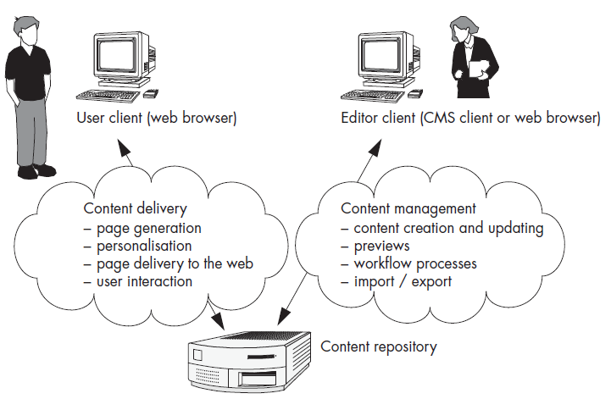
Content Management and Content Delivery (cont.)

Slide 13
Dynamic Content Delivery plus Caching
How can you ensure that the site is always up-to-date and reflects the latest changes made by the content editors? How can you lay the foundation for interaction and personalization?
Combine dynamic content delivery with powerful caching strategies. Choose a content management system that generates web pages on request and offers caching mechanisms sufficient to meet your performance requirements.

Slide 14
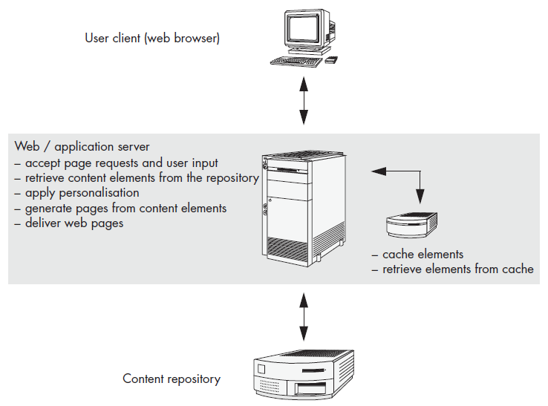
Dynamic Content Delivery plus Caching (cont.)

Slide 15
Sensible Client-Side Interaction
How can you ensure that your site features the desired degree of interaction and user participation while maintaining reasonable system performance?
Use Ajax-based client-side interaction, but use it with care. Retain the concept of a web page and apply server-side event handling for all navigation purposes, but also apply event handling inside the browser to adjust the way in which information elements are presented within a web page. Combine this with asynchronous server calls if the browser has to load data from the server.

Slide 16
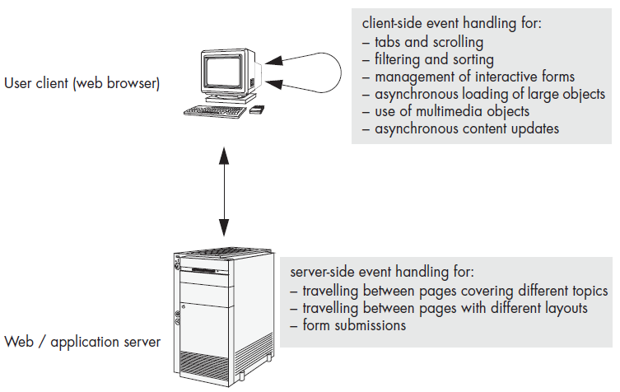
Sensible Client-Side Interaction (cont.)

Slide 17
Listener-Based Synchronization
How can you avoid inconsistencies between content in the repository and content stored by other components?
Establish repository listeners – asynchronous processes that react to specific workflow events and notify interested components of relevant changes made to content artifacts in the repository.

Slide 18
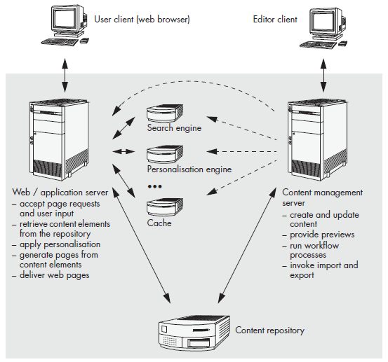
Listener-Based Synchronization (cont.)

Slide 19
Layered Architecture for Content Delivery
How can you prevent the server-side custom software for content delivery from becoming difficult or impossible to maintain? How can you avoid a server-side architecture that doesn’t scale properly?
Define a server-side architecture that consists of three distinct layers. The bottom layer encapsulates all access to the content repository. The middle layer provides the domain logic. The top layer contains the templates that are used for page generation.

Slide 20
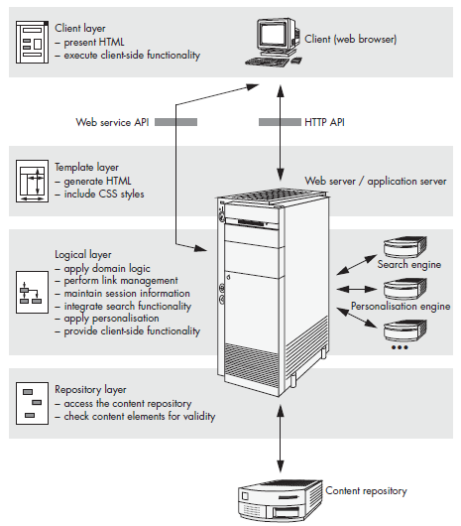
Layered Architecture for Content Delivery (cont.)

Slide 21
Content Type Hierarchy
How can you ensure that content editors can maintain artifacts that are meaningful to them in a way that is straightforward and avoids redundant information?
Introduce a content model in which content types represent domain-motivated artifacts consisting of basic building blocks such as texts, pictures, multimedia objects and links. Apply object-oriented modeling techniques to express abstraction and association relationships between content types.

Slide 22
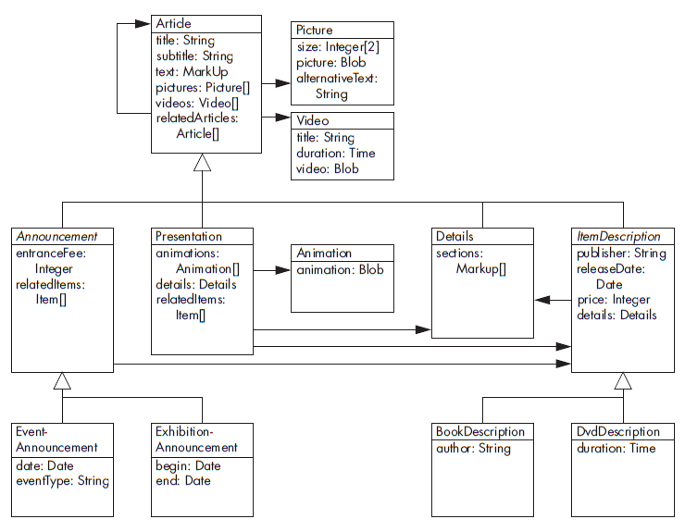
Content Type Hierarchy (cont.)

Slide 23
Decoupling of Content and Navigation
How can you ensure that content editors can organize both the content and the navigation hierarchy in a straightforward and flexible way? How can you support different content hierarchies for different sites, like an intranet and an extranet, or for different countries or distribution channels?
Decouple the navigation hierarchy from the content. Introduce dedicated navigation nodes that span the navigation hierarchy. Allow the navigation nodes to be attributed with configuration information if the navigation hierarchy needs to vary across different contexts.

Slide 24
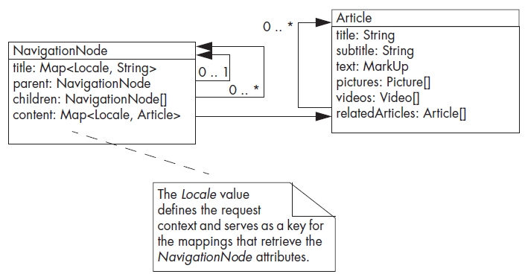
Decoupling of Content and Navigation (cont.)

Slide 25
Dynamic Content Linking
How can frequently changing content be maintained without burdening the content editors with the tedious job of manually linking the new content into the navigation hierarchy?
Establish dynamic lists that, instead of maintaining links to any content elements, specify criteria for potential list items, meaning that when a page featuring a dynamic list is generated, the repository is searched for content elements that match these criteria.

Slide 26
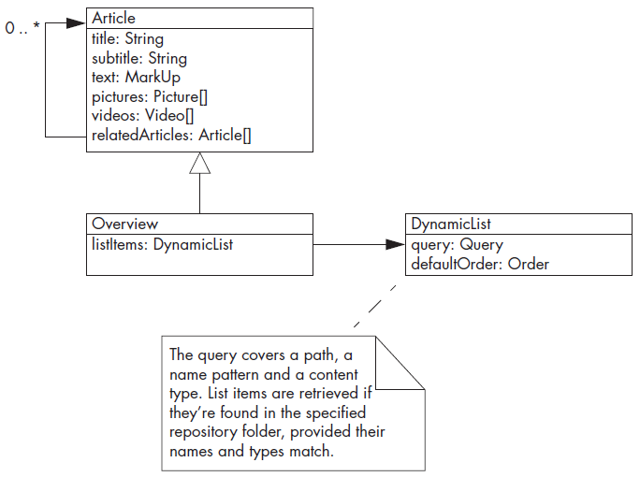
Dynamic Content Linking (cont.)

Slide 27
Taxonomy Based on Keywords and Categories
How can you lay the foundations for an effective and powerful search function?
Build a taxonomy that combines arbitrary keywords with well-defined content categories. Make sure that individual content elements can be attributed with lists of keywords. In addition, establish a set of possibly overlapping content categories to which individual content elements can be assigned.

Slide 28
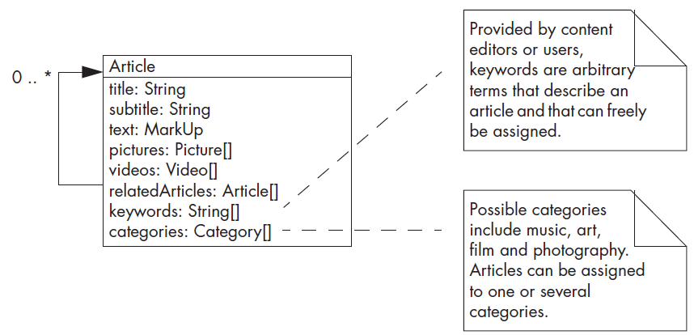
Taxonomy Based on Keywords and Categories (cont.)

Slide 29
Taxonomy Based on Keywords and Categories (cont.)
Liabilities
Because arbitrary keywords are possible, undesired mismatches between search terms and keywords can occur.
The reorganization of categories can be expensive.

Slide 30
Workflow-Based Validation
How can you avoid content elements with illegal or inconsistent attribute values?
Apply validators that check content for plausibility. Integrate these validators into the content editors’ workflow in two ways: validators that reject illegal attribute values should be applied during the editing process, while validators that check for completeness and consistency should only be applied on publication.

Slide 31
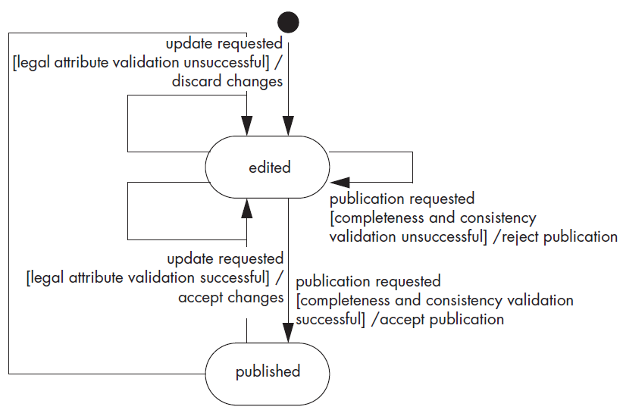
Workflow-Based Validation (cont.)

Slide 32
Content Services
How can you avoid domain logic being scattered all over your server-side components?
Implement services that provide the content aggregates that the various pages of your site may require. This begins with single content elements from the repository, but also includes lists or compositions of content elements.
If necessary, content services must apply personalization.
Whatever the content services make available, it must be ready to be processed by the presentation logic.

Slide 34
Motivation: CMS Features (I)
Built-in security (with extensibility): users, roles, permissions, authentication.
Content creation, content publishing, publishing workflow, timed publishing.
Auditing.
External applications integration (placeholders for custom sections/pages).
Performance: The number of concurrent users the site can support with predefined network and hardware.
SEO
Scalability

Slide 35
Motivation: CMS Features (II)
Content: Underlying models, classifications and lifecycles
Custom content types
Migrate data schema from one environment to another (e.g from development to test to production)
Automated
Transactional
Rolling back
Content representation, user interaction, data integration
Modular UI

Slide 37

Building a Corporate Website (I)
Kicked off meeting
Which audience(s) do we want the corporate site to serve?
What is the relative importance of each audience?
What do we want each audience to know?
On the homepage, how should we answer the question: "What do we do?"
What are the problems with our current corporate site?

Slide 38
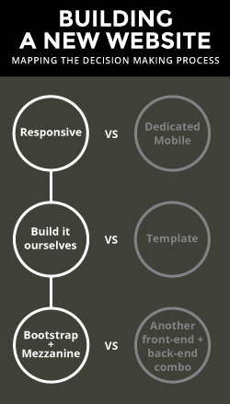
Building a Corporate Website (II)
Design and Development
Should we build a responsive framework or opt for a dedicated mobile site?
Should we purchase a template or build the site ourselves?
Which combination of front-end/back-end frameworks should we use?

Slide 40
Cloud CMS
https://www.cloudcms.com/index.html
Cloud CMS is a headless, API-first approach to content management, built around JSON and a high performance cloud architecture. It delivers enterprise features, including flexible content models and a full editorial environment, allowing your business users to create, manage and publish fresh content with ease.
Cloud CMS is available as a hosted subscription or as Docker containers that you can run on-premise or host within your own private cloud. Cloud CMS runs on top of MongoDB, ElasticSearch and Amazon AWS.

Slide 41
Get Started with Cloud CMS
https://www.cloudcms.com/quickstart.html

Slide 42

Thank You & See You Again

